Slide 1


Kubernetes Extension Points With Deep Dive into Custom Resource Definitions
Jungho Kim, Architech
December 11, 2018

Slide 2
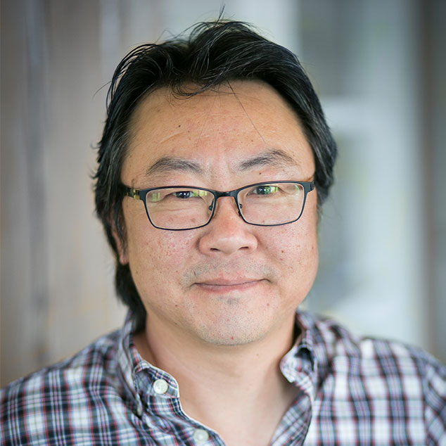
Agenda
Quick overview of Kubernetes extensions points then focus on Custom Resource Definitions (CRDs) and Custom Controllers
Deep dive into CRDs, the basis for “Operators”
Use-cases from the community
Prometheus Operator
Jenkins-X
Roll your own example to get the concept
Using Kubebuilder
Using Operator SDK
Twitter: @jungho_kim
LinkedIn: @junghokim
GitHub: @jungho

Slide 3
Desired Outcome
Learn how extensible K8S can be
Understand better the inner workings of Kubernetes
Spark your imagination to leverage Kubernetes in more powerful ways
Start your journey to becoming a K8S ninja!

Slide 4
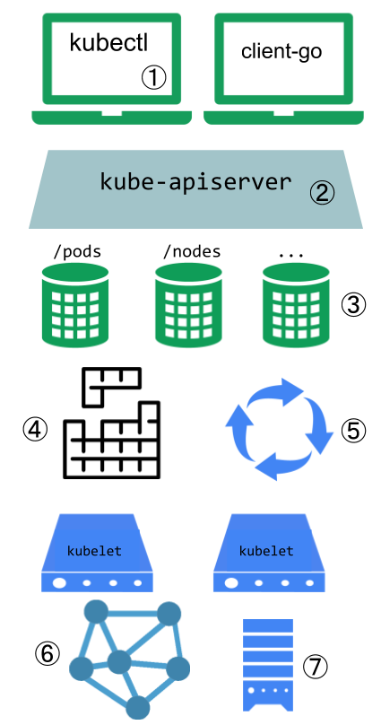
Kubernetes Extension Points
K8S is incredibly extensible
Designed with well-defined extension points to extend/customize the platform
Plugins for kubectl to add additional kubectl commands (you can’t overwrite existing commands)
Authn/Authr, Webhooks, Admission Controllers, Dynamic Admission Control, API Aggregation
Custom Resource Definitions
Scheduler extensions. You can replace the default scheduler, use multiple schedulers, extend scheduler behaviours via webhooks
Controllers that reconciles current-state to desired state.
Network Plugins e.g. Container Network Interface (CNI) plugins such as Celium, Calico, Azure CNI
Storage Plugins e.g. Flex Volumes
https://bit.ly/2r6qKTp

Slide 5
Custom Resource Definitions

Slide 6
Operators

Slide 7
Prometheus Operator

Slide 8
Jenkins-X

Slide 9
Simple CRD and Custom Controller
https://github.com/luksa/k8s-website-controller

Slide 10
KubeBuilder

Slide 11
Operator SDK

Slide 12

We use open source, cloud-native technologies to modernize systems.
Notes:
14 Years
300+ Projects
Enterprise Story
Entrepreneurial
Modernize: Government, Banks, Canadian Tire, Telcos
Integrated Team Approach, over 100 people
Mix of Product Innovation, Modernization, and enabling / empowering the existing teams.
We build platforms and digital products.

Slide 13








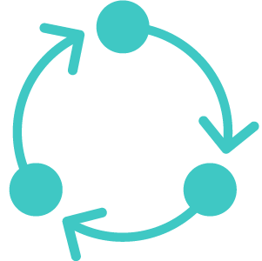


Integrated Development Studio
+
+
14
300
Strategy
Design
Engineering
Analytics
Support
years
projects
Digital Transformation
Product Innovation
Legacy Modernization
Team Enablement
+
+
100
40
Modern Product Development
people
systems modernized
Lean
Startup
Design Thinking
Agile Engineering
Notes:
We know that great software development takes a customer-first approach, embracing innovation, experimentation and discipline.
Integrated Team Approach, over 100 people
Mix of Product Innovation, Modernization, and enabling / empowering the existing teams.
We build platforms and digital products.

Slide 14






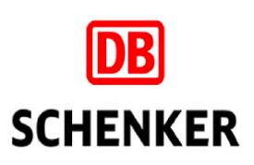


















Digital Transformation Journeys
Notes:
These are mostly incumbents.
Modernize: Government, Banks, Canadian Tire, Telcos

Slide 15


“
We’re trying to become an organization that’s constantly rethinking the problems we’re solving in the market today and looking to bring new value to clients in ways that they haven’t thought of yet. Architech is instrumental to us throughout this journey.
Hugh Cumming, Chief Technology Officer, Finastra ($2B+ fintech)
Notes:
Here’s an incumbent, formerly D+H (the cheque company), that is re-inventing themselves to become the world’s largest fintech.

Slide 16







Open Source Experts in the Cloud
Reduced Costs
Enhanced Supportability
Massive Global Adoption
Avoid Vendor Lock-In
Availability, Resiliency, Security
Achieve True Business Agility

Slide 17

70 Bond St., Suite 400 Toronto, ON, Canada M5B 1XB
P: 416.607.5618 F: 416.352.1768 www.architech.ca
©2017 Architech. All Rights Reserved.

